Slide 1


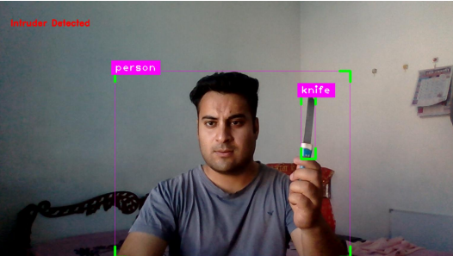
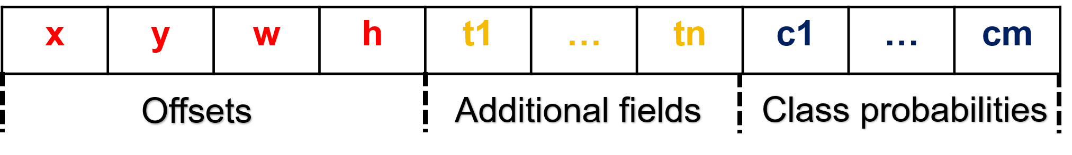

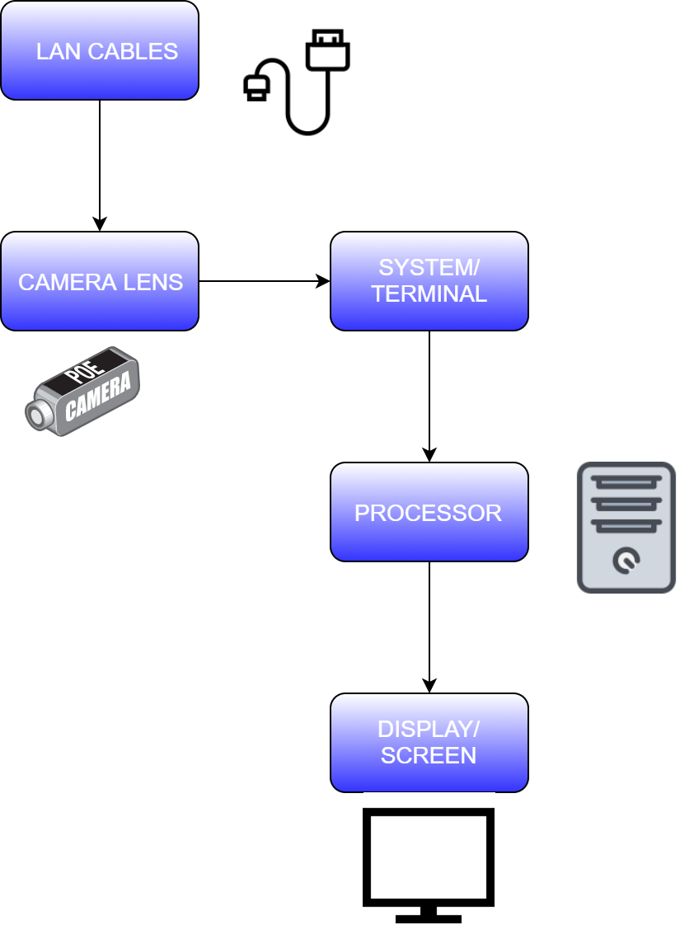
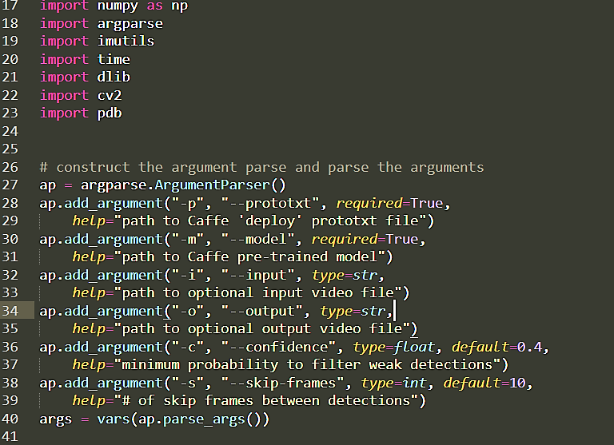

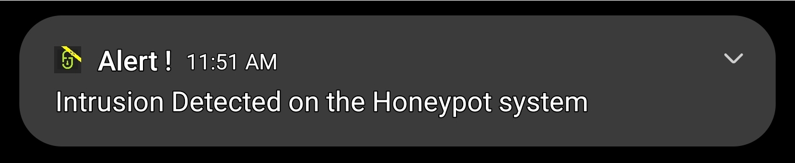
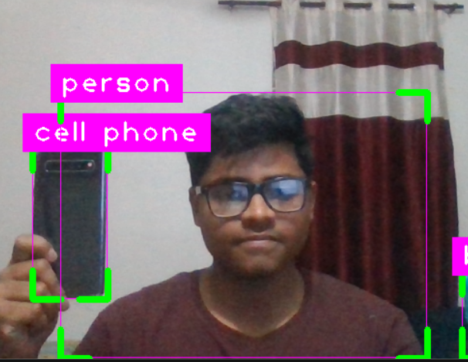

INTRUDER DETECTION FRAMEWORK
AADHAAR KOUL (CSE - A1)
EMAIL: 2020a1r040@mietjammu.in
PHONE: +91-6005846156
Abstract
Data Processing Workflow
Cyber-crime now a days is booming at an alarming rate. The naiveness and the lack of awareness among the users has increased the rate of cyber-crime by a large number. The most common attacks to which the users are most susceptible are the phishing and the MITM(Man In The Middle Attacks) that are usually carried out on the free public WIFI's and home gateways. An estimate of about 10.5 Trillion Dollars is the round figure that cyber frauds are going to cost the world in the coming years.To address this problem We have come up with a solution to implement an intruder detection framework that takes care of the parameter , network and system security by using state of the art technologies like artificial intelligence and honeypot systems.To make the product Seamless and easy to use for a naive user we have come up with one stop solution software that integrates with all the branches of the framework and generates smart analytics that are accessible on a user’s smartphone as well .The OSS uses smart notification based flagging system that smartly classifies the level of threat in any system and delivers it securely to the admin .The product uses the high tech features that of a large scale IDS but delivers them at a very low cost. The product has branches rang from close platform support that include windows Systems Internet browsers and Android devices .The cross platform Functionality of the product Tries to maintain the absolute standards of the CIA trait .
INPUT VIDEO FEED
SURVELLIANCE MODULE
Each feature map is
divided into cells with anchor boxes.
Each anchor box predicts offsets, additional fields, and class probabilities.
Innovation & Impact
THREAT CLASSIFICATION
INNOVATION:
Threat level based intruder detection classification
Smart Notification based flag alerting system
Chatbot based IOT Controlling
IMPACT:
Reducing the overall cyber crime cost across India.
Threat Lv 1
Threat Lv 2
Threat Lv 3
OUTPUT
Functional Workflow
Architecture Diagram
INTRUDER VECTOR
User turns on the IDS
Keep True
Honeypots , Notification systems , Detection sensors , Network Sniffers , and the web app portals are configured and turned on.
Intrusion
Detected
NO
IOT SENSOR DETECTION
NO
NO
YES
Admin blocks
the intruder / Enables security protocols
Tables and databases
Updated
Admin takes necessary actions
YES
INTRUDER CLASSIFICATION
YES
Intruder information saved via honeypots
Smart Notification
System sends alerts and advisory messages to the admin
All Systems lockdown,
Intruder Blocked from
entering the system
SMART NOTIFICATION / ALARM
Interaction Model
Ultrasonics
LOCKDOWN PROTOCOL
IP surveillance camera
Network Sniffer
Honeypot Systems
Laser sensors
Home Security system
Motion Sensors
Detection Sensors
VPN
Wi-Fi
Smart Notification System
PIR Sensors
Door Lock
Intrusion Detection Framework
Admin control application
Language(s) | Technology Stack
LANGUAGES:
C# , Java , XML , HTML , CSS , JS , Python , Arduino ,
TECHNOLOGY STACK:
COMPUTER VISION - Ultralytics , CVZone , YOLO
IOT - Arduino , ESP8266 , Blynk Cloud , Sensors
Cloud - Blynk , AWS , Github , Vercel
API(S):
Rapid API , BLynk API
Arduino
Home Gateway
Media Server
Appliances
Appliances
WWW
TV
Storage
Project Code: - COM-811

